Slide 1
Driving sales via Proximity Beacons
BY: SHREYA BHARGAVA
MOHAMMAD UMAIR

Slide 2
Project Overview
Our project aims at driving advertisements to customers based on their proximity with a store in a shopping complex
We plan to use the user’s information to figure out the kind of products a customer might be interested in
The same system can be used to send coupons, discounts and loyalty points to the user
The whole in-place system can be used to implement indoor navigation as well

Slide 3
Research papers read
An iBeacon-based Indoor Positioning Systems for Hospitals - https://pdfs.semanticscholar.org/8383/676dc6961003776e363494b0be01520a6f1e.pdf
Towards an indoor navigation system using Bluetooth Low Energy Beacons - https://ieeexplore.ieee.org/abstract/document/8247464
Improving Indoor Localization Using Bluetooth Low Energy Beacons - https://www.hindawi.com/journals/misy/2016/2083094/abs/
Occupancy Detection for Building Emergency Management Using BLE Beacons - https://link.springer.com/chapter/10.1007/978-3-319-47217-1_25

Slide 4
Team members roles
Shreya Bhargava:
Beacon Literature Study,Research work
Impact of AI (Background Literature Study including various use cases)
Analysis on Big Data
Applying analysis on real world application:
Customer Reviews (Amazon Alexa customer dataset)
Visualization and providing the filtered output to the targeted customer.
Mohammad Umair:
Client side infrastructure
Research about the Android APIs and find the best way to communicate with beacons
Figure ways to lower down battery usage
UI and UX of the Android app to make it user friendly

Slide 5
Beacons Overview
Bluetooth beacons are no more than small Bluetooth devices that broadcast a radio signal called an “advertisement” and follows standard Low Energy Bluetooth protocols set out by the Bluetooth SIG.
This makes them compatible with any other Bluetooth device.
Their range can vary, some have a signal that goes no more than a few meters, and others can reach a hundred meters plus.
With Bluetooth 5, Bluetooth beacons will have transmission ranges of many hundreds of meters, exceeding the range of wifi in certain cases.

Slide 6
Technical Details:
MCU (Micro Controller Unit) Specs:
ARM® Cortex®-M4 32-bit processor with FPU
64 MHz Core speed
512 kB Flash memory
64 kB RAM memory
Other Specs:
Radio: 2.4 GHz transceiver
Bluetooth® 4.2 LE standard
Range: up to 70 meters (230 feet)
Output Power: -20 to +4 dBm in 4 dB steps, “Whisper mode” -40 dBm
Frequency range: 2400 MHz to 2483.5 MHz
Over-the-air data rate: 1 Mbps (2 Mbps supported)
Power Supply - 1 x CR2477 – 3.0V lithium primary cell battery (replaceable)

Slide 7
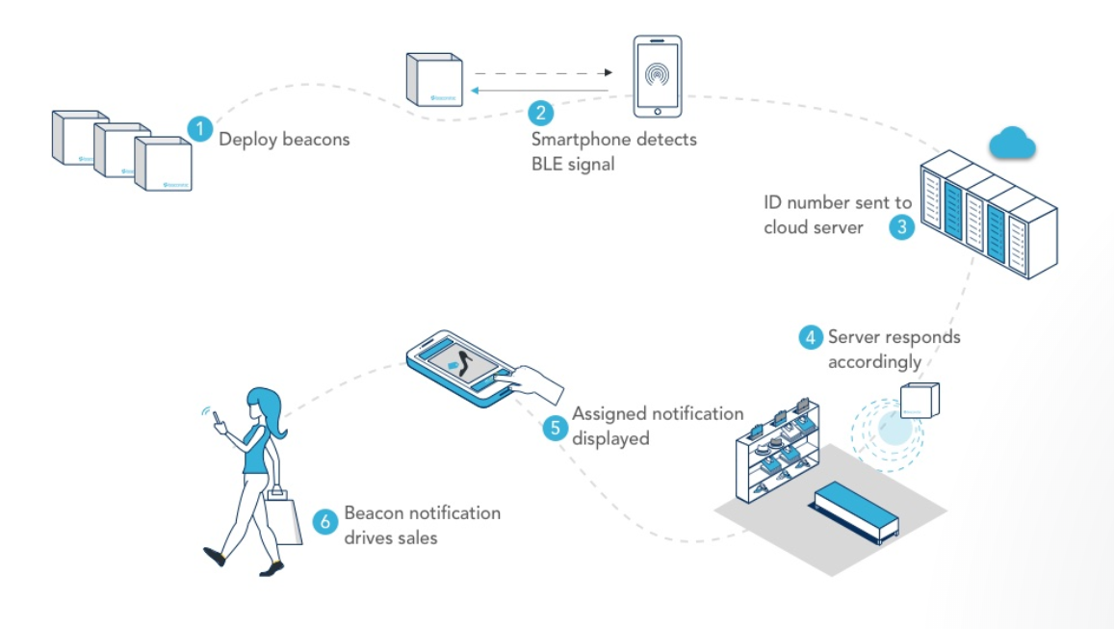
Basic Design:

Slide 8
Android Application Overview
Android application uses the Proximity Sensor API via a 3rd party library - https://altbeacon.github.io/android-beacon-library/index.html
The application keeps running in the background and listens for Bluetooth signals, watching for beacons
App receives the UUID from the beacon, sends this UUID and the user’s Facebook Access Token to the server and receives the advertisement related to the particular user.

Slide 9
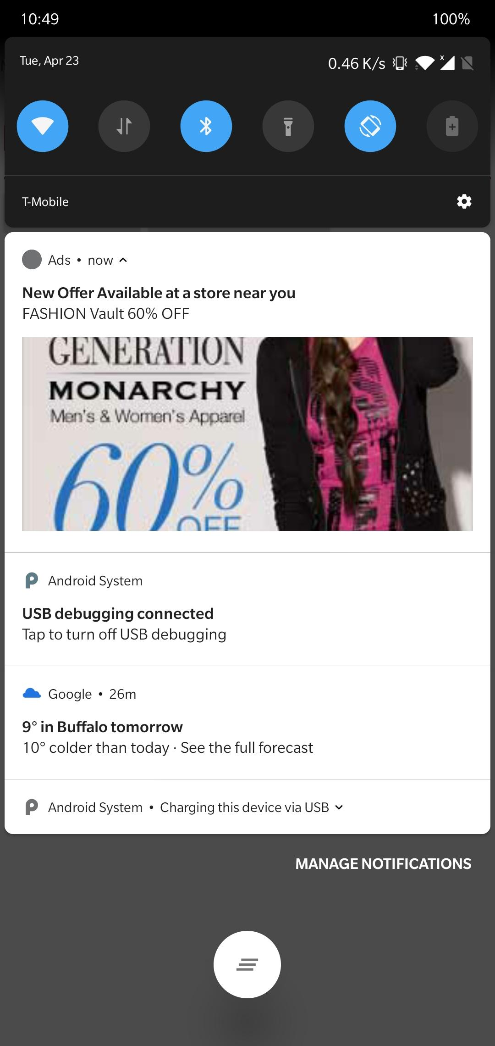
Demo
Using Beacon Simulator to simulate a beacon on an Android device.
As soon as the beacon comes into phone’s proximity, the app detects that a supported beacon has been detected.
The app sends a request to the server, receives an Ad.
The Ad is then displayed on the device as a notification.

Slide 10
Related articles:
Apple iBeacon technology briefing - https://link.springer.com/article/10.1057/dddmp.2014.7
AI Machine Learning with Beacons - https://www.beaconzone.co.uk/machinelearning
Android AltBeacon Library - https://github.com/AltBeacon/android-beacon-library

Slide 11
Impact of AI in our project
Our work in AI and machine learning grew out of our use of beacons in sensing and collection of data
Beacons can help you gather data about your customers’ behavior, which a valuable asset for a company.
Once you have a large data set, you can send more targeted messages. Without AI, your beacon might “see” Customer Joe walk into your store and send him a message that says, “You have three days left to use your loyalty points before they expire.” The program recognizes Joe and can pull his data.
AI can help connect Joe to other events, such as his friend’s birthday coming up or the fact that he just got a new job and therefore may need new clothes.

Slide 12
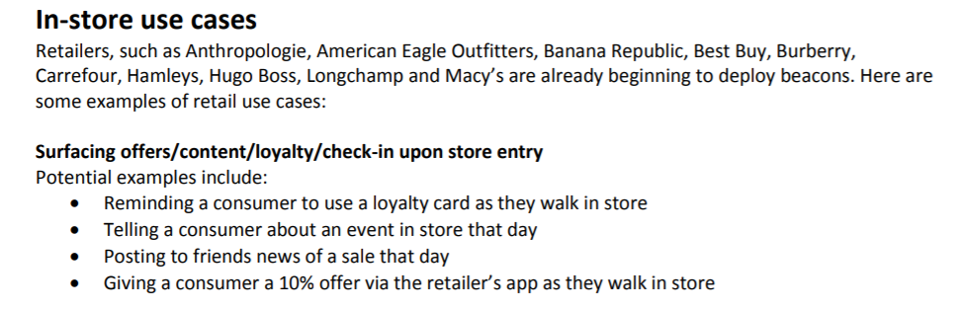

Slide 13
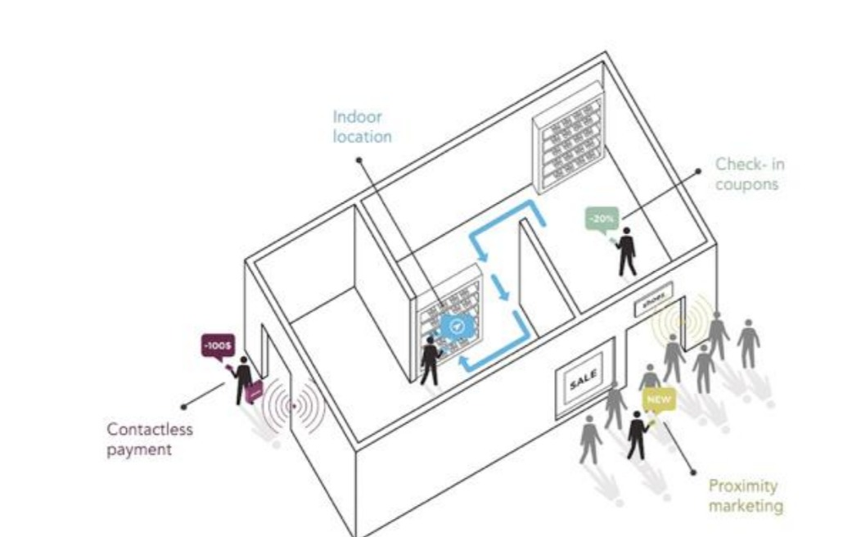
Impact of AI in our project (contd)

Slide 14
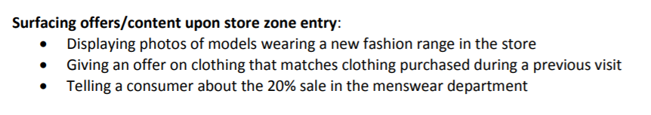
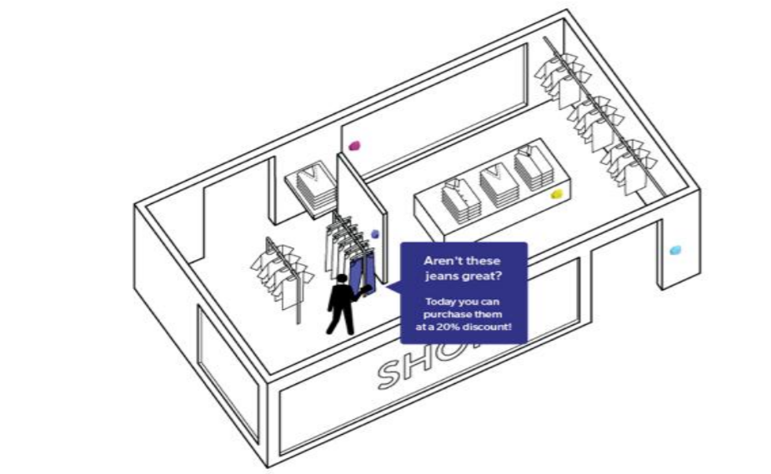

Slide 15
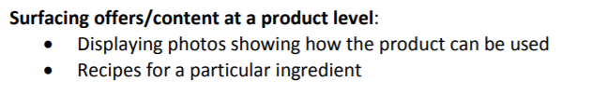
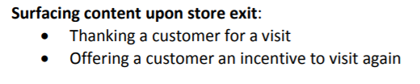


Slide 16
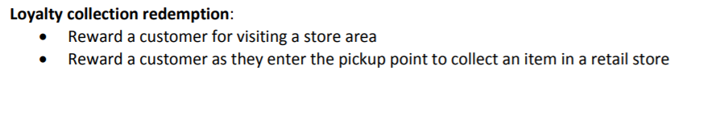
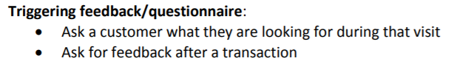
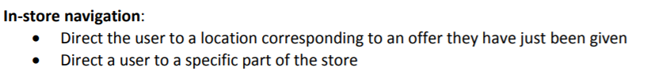

Slide 17
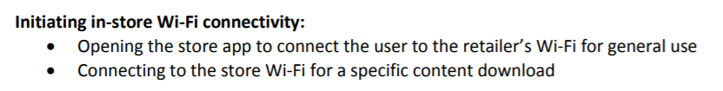
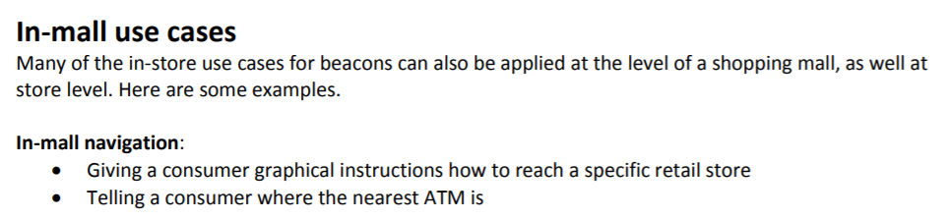

Slide 18
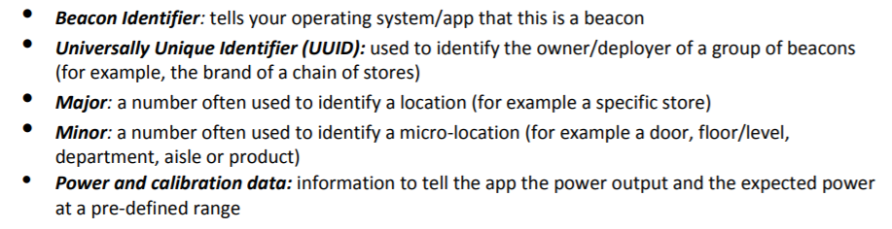
Integrate with personal mobile phones:
The broadcast consists of information in four parts:

Slide 19
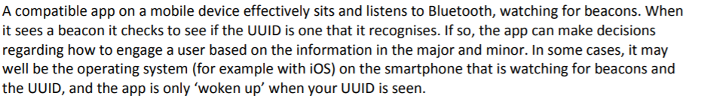

Slide 20
Motivation to look forward:
These are just a few of the possibilities. Because beacons and AI are newer to many businesses, there is a lot of potential to think big.
Every company that works to build something of their own will incorporate AI... AI is perhaps the most transformative thing that's ever happened”
Satya Nadella, CEO Microsoft.
Machine learning finds hidden gems in data and results in 'models' that can detect, classify and forecast. Feeding the resultant intelligence back into your organization solves problems that previously seemed too complex and impossible to solve by humans. Solving these problems often improves efficiency, saves costs, increases competitiveness and can even create new intellectual property for your organization.

Slide 21
Technical Specifications:
# to be done by Umair
Android Application:

Slide 22
How request is going to be handled:
When a customer comes in the proximity of retail shop, beacon sends a requests to the server, and in response server sends a json response.
The json response is then sent to the targeted customer.

Slide 23
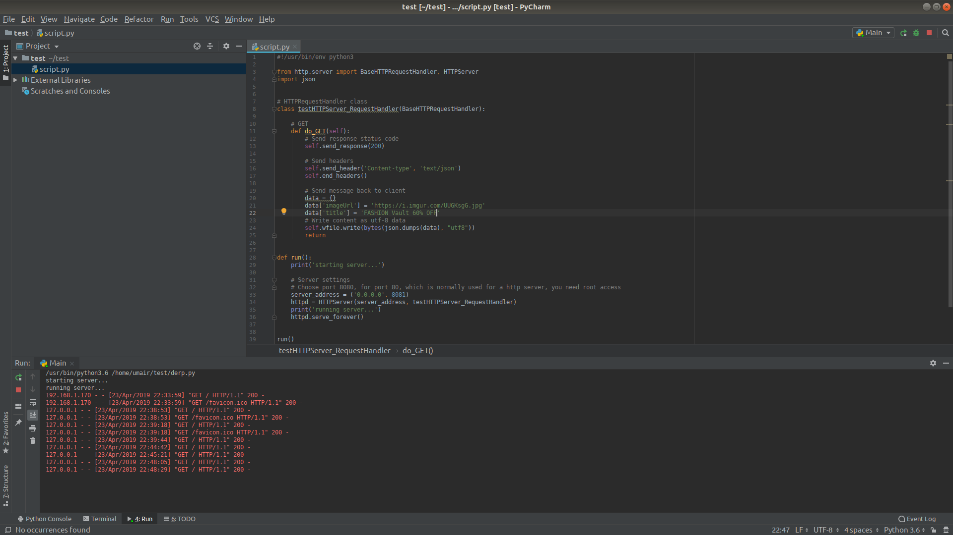
Let’s scrutinize further how requests is going to be handled.

Slide 24

Outcome so far…
Mobile Screenshot

Slide 25
Implementation to look forward:
As per the progress, we are now able to send the image url along with its title return back to the client which we have already depicted in the attached screenshot.
But how to make it more appealing ????
Our approach: What if we take the some existing large data set?

Slide 26
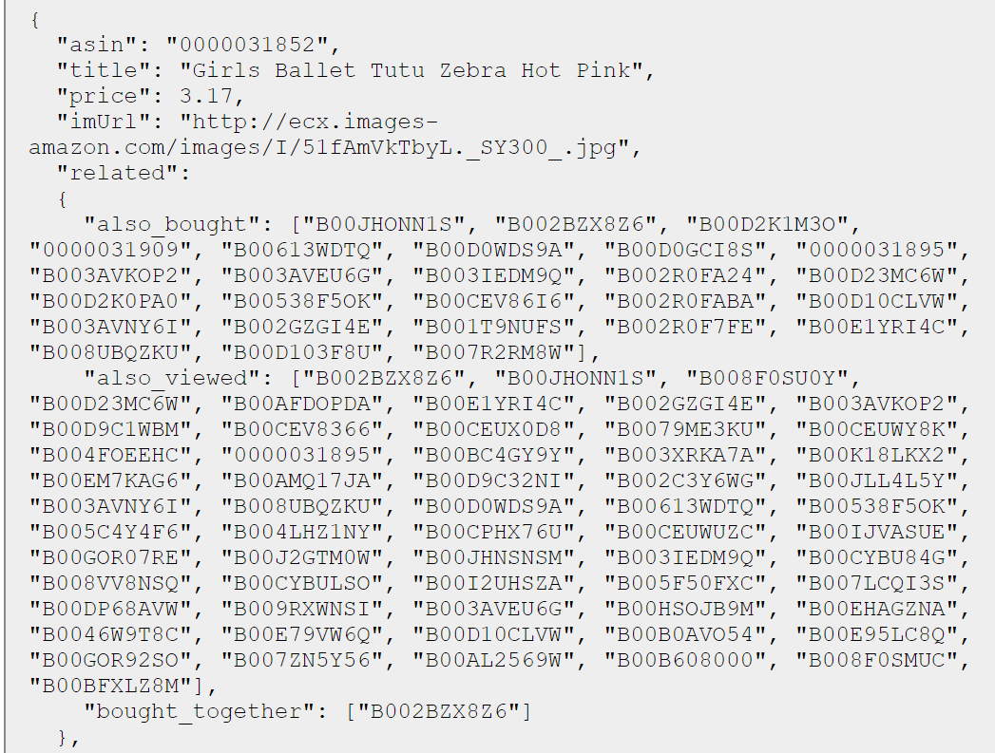
What if data is fetched dynamically based on user preferences?

Slide 27
We can include fields like:
Recently bought together so that we can send more appealing data to the customer, hence raises the overall market value of the retailer.
What all his/her interest on different social sites catch the relevant keywords and generate a relevant graph, so that retailer can easily analyse the interest of the customer.
Taking reviews from the customer and update the dataset so that more filtered features appears on the list.

Slide 28
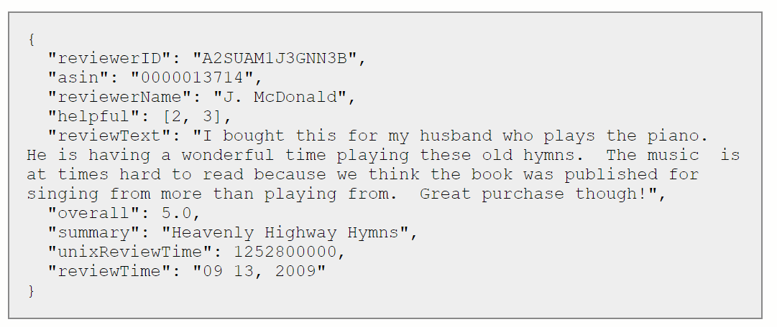
How Reviews Data may look like:

Slide 29
Our goal:
The large data set can be treated as python dictionary objects(once we are able to access it.
Then fetching this Big data in the form of pandas data frames .
Visualize the data based on the keyword, for specific customers and for the retailers.
Sending notifications to the client based on the frequency of visit to that shop.

Slide 30
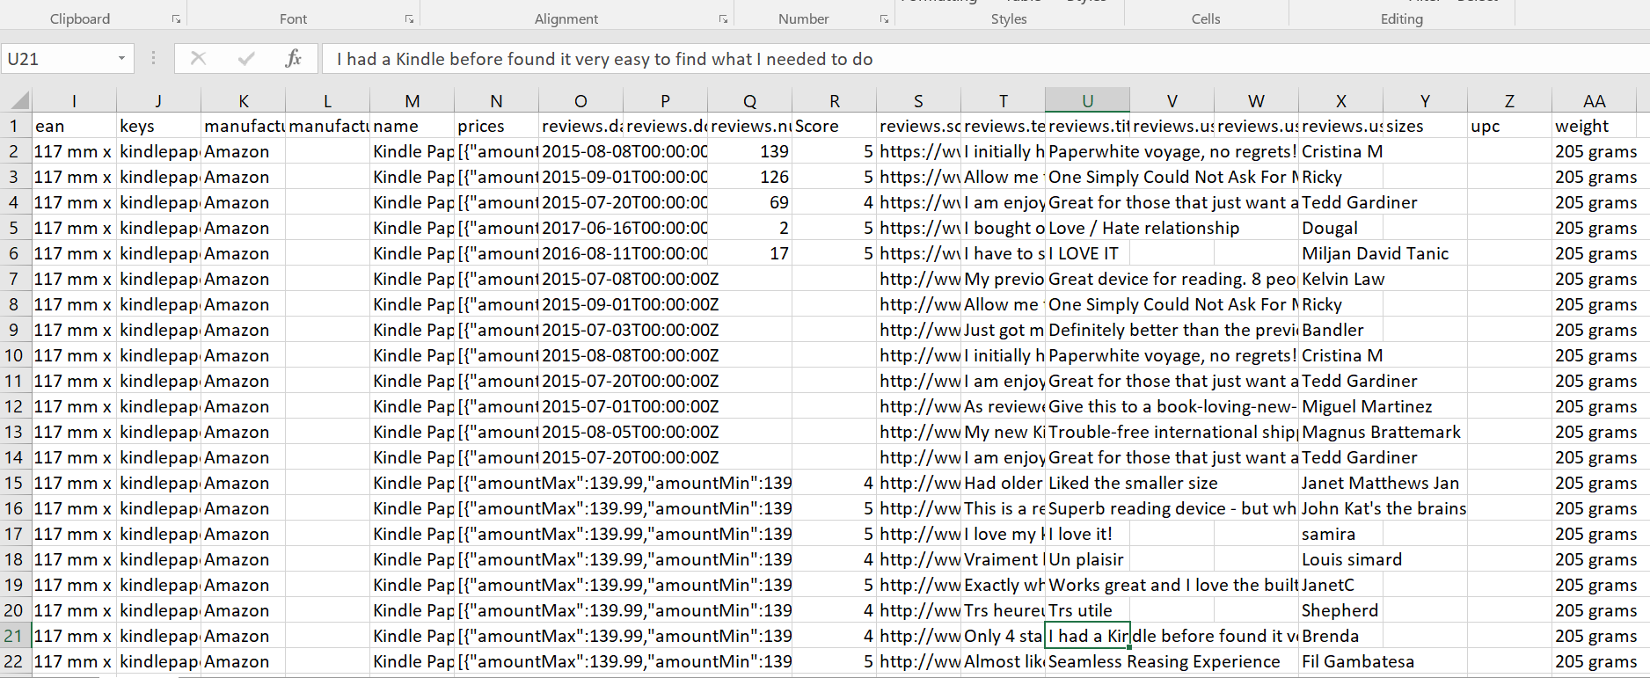
Sample data:

Slide 31
Looking Forward:
We have downloaded the Amazon’s sample customer’s data which we will feed into our training model so that based on the sentimental analysis by bifurcating the words into positive and negative feedbacks given by the customer we will send the notifications to the desired customers.
Hence our objective will be achieved.

Slide 32
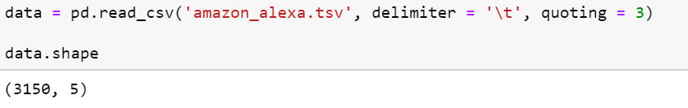
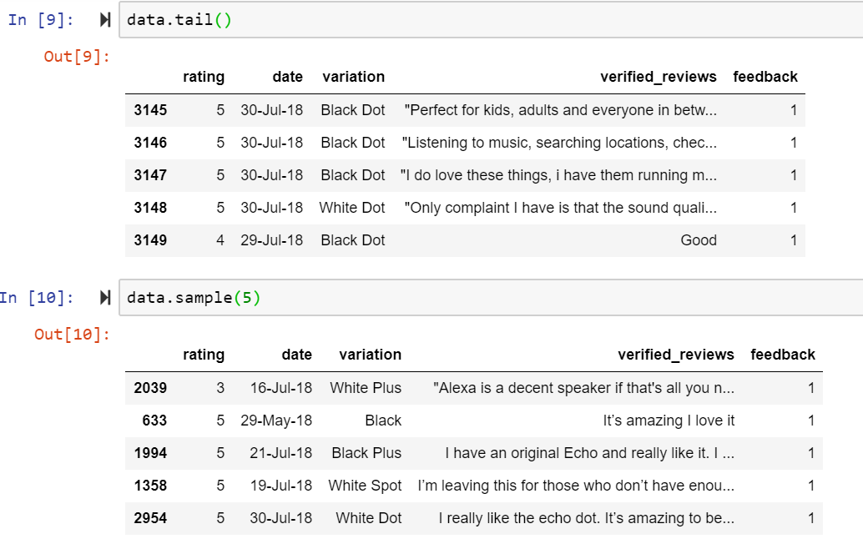
Visualization & Final Outcome:
Downloading & Loading the data:

Slide 33
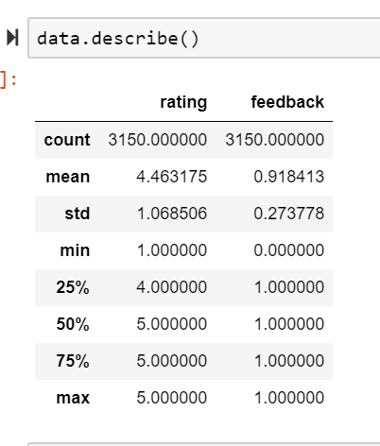
Data Description:

Slide 34
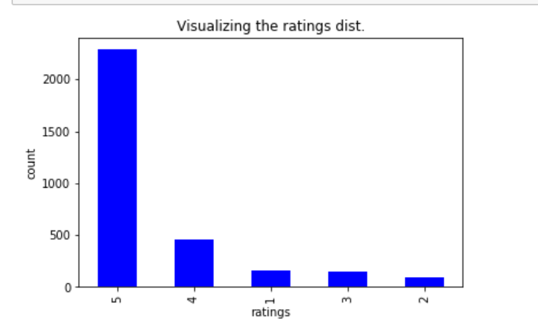
Visualizations:
1.Various ratings given by customers:

Slide 35
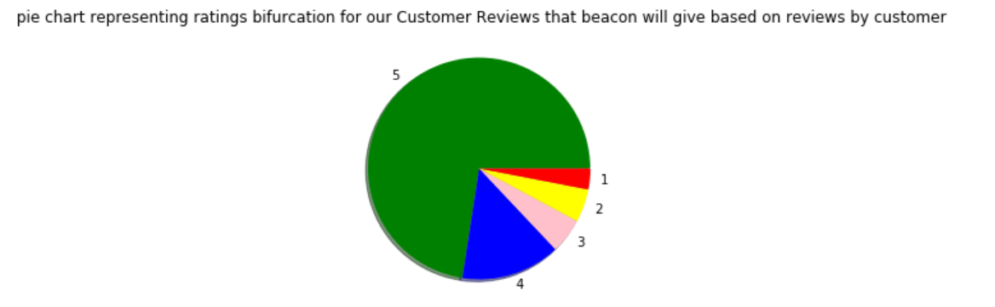
2. Ratings:

Slide 36
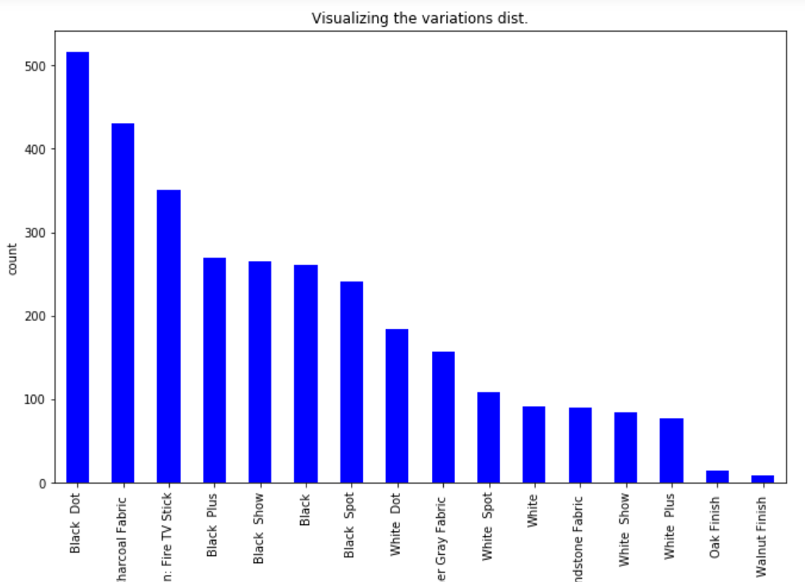
3. Visualization based on variations of Amazon Alexa:

Slide 37
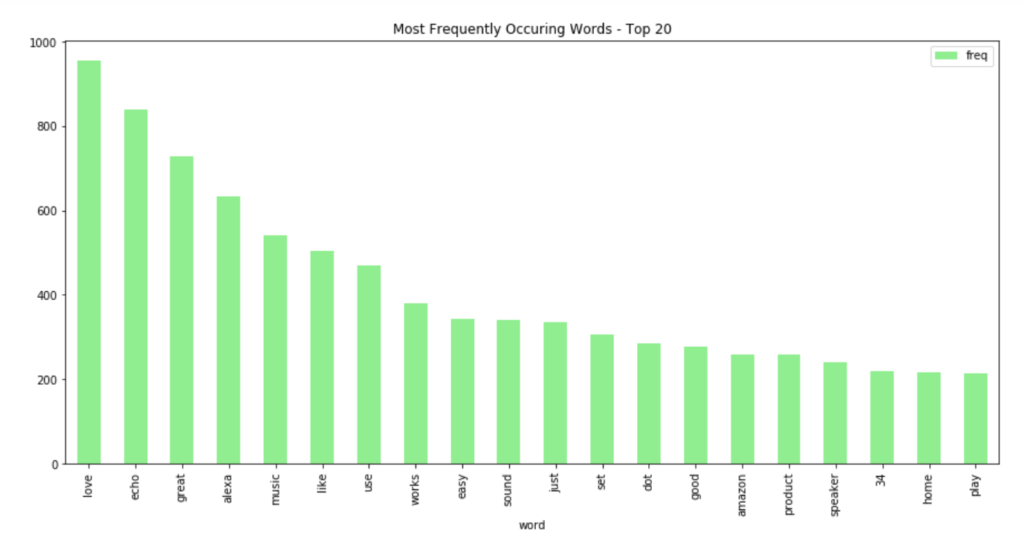
4. Analysis on words: Visualizing the most frequent words

Slide 38
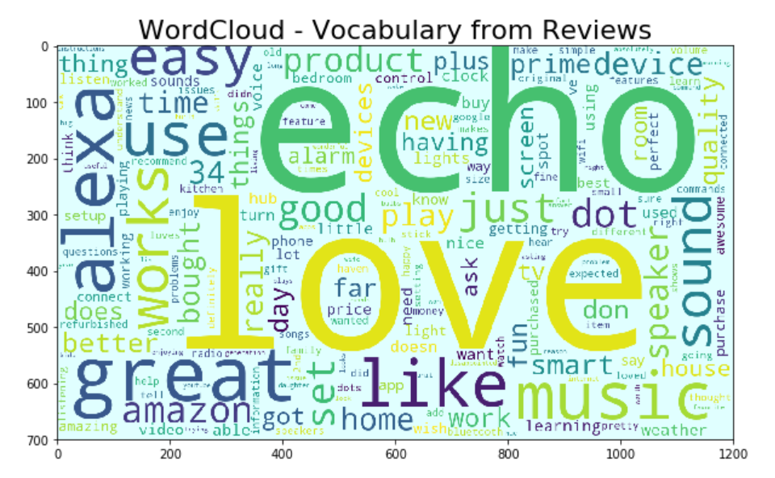
5. Creating a Word Cloud for the previously obtained frequent words:

Slide 39
References:
Dataset: Amazon Development customer review dataset

Slide 40
Summary:
We are able to display advertisements whenever customer comes in the proximity of beacons, Moreover only filtered ads will be sent to the targeted customers.
Visualization is done using AI and by implementing machine learning algorithms in python to analyse the large data set of Amazon Customer Reviews on Alexa.

Slide 41
Thanks!!!!!

